Slide 1
Operationalizing Azure Kubernetes Service
Hands-On Challenge

Slide 2
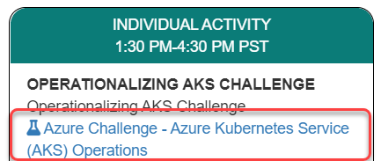
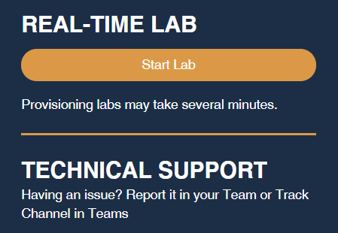
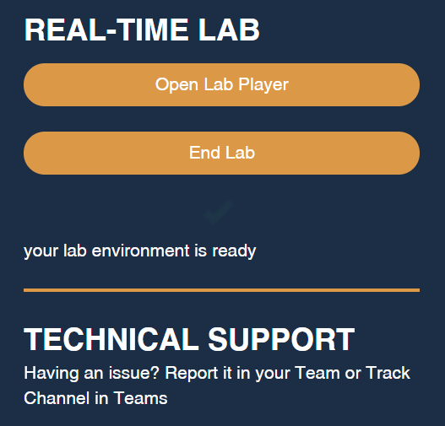
Launch the Lab Environment
Important! Allow at least 1 hour for your lab to start

Slide 3
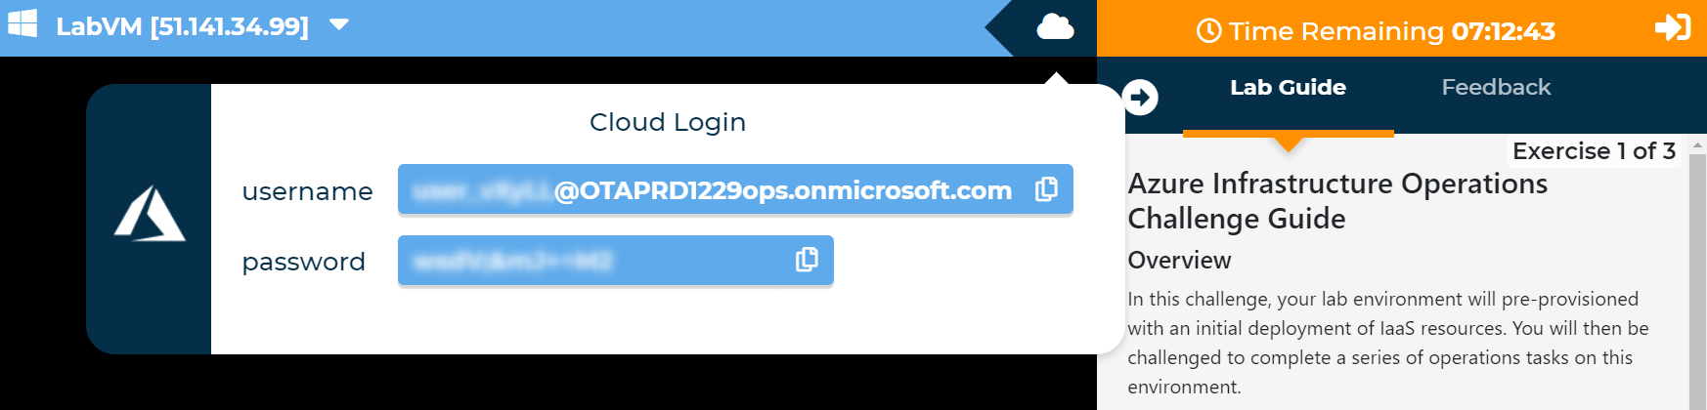
Access Your Lab
Important! Allow at least 1 hour for your lab to start

Slide 4
Challenges
Challenge 1: Implementing AKS to meeting customer requirements
Create a new cluster, migrate an application, and configure a new security model
Isolating workloads with multiple node pools
Add node pools and work towards workload isolation
Challenge 3: Monitoring containerized workloads
Implement monitor for multiple workloads hosted in AKS
Note Automatic validation of your solution has been disabled to speed up the lab for you
Notes:
A new customer, Fruit Smashers, has approached to you take on the management and operations of one or more containerized applications which are hosted in an existing Azure Kubernetes Service (AKS) cluster. Currently, a popular website for rating fruit smoothie flavors - Fruit Smoothies by Fruit Smashers - is deployed in the cluster and a new application will be coming online shortly to allow guests to Fruit Smashers corporate headquarters to leave messages about the favorite part of their visit. While the existing platform and underlying deployment(s) meet the needs of the business, Fruit Smashers plans to grow their online presence significantly as more customers move to online ordering exclusively. They anticipate that growth will be organic and bursty.
The lab will not validate that each challenge has been completed correctly, so pay close attention to the requirements in each challenge.

Slide 5
Need help?
Use the Teams chat channel
Solutions will be given in tomorrow morning's kick-off session

